Slide 1








Real-Time Noise Pollution Monitoring and Control System
Batch-4

Slide 2




Our Team
22BCE1204
Karthik V
22BCE1633
Vadali Venkata Vyas
22BCE1648
Aditya Vikram Mahanta
22BCE1768
Daksh Lakotiya
22BAI1266
Afzal Ahamed Shaheena

Slide 3




Background
Noise pollution is a global environmental and health concern affecting millions. In our urbanized world, constant exposure to traffic, industry, and recreational noise disrupts tranquility, impacting human well-being and ecosystems. Beyond mere annoyance, chronic exposure to high noise levels leads to stress, sleep disturbances, and health issues, including cardiovascular problems. Wildlife also suffers as communication and navigation among species are disrupted. Addressing this requires a holistic approach, incorporating urban planning, technology, and public awareness to mitigate noise pollution's adverse effects. By creating quieter environments, we can safeguard both human health and the delicate balance of ecosystems for a more harmonious coexistence.

Slide 4
Objective
The objective of this project is to develop a real-time noise pollution monitoring and control system using a microcontroller and relevant sensors. The system should be able to:
Monitor ambient noise levels in real-time using a microphone sensor
Process the sensor data using digital signal processing techniques to calculate sound levels
Display current noise levels on an LCD or OLED display
Optimize power consumption of the system
Send alerts when noise levels exceed defined thresholds signifying noise pollution
Make the system as cost efficient as possible

Slide 5








Checkpoints
Noise Pollution Detection & Monitoring
Less Power consumption, more efficient, affordable and compact

Slide 6
Abstract
Noise pollution has become a major issue in urban environments due to traffic, industries and other anthropogenic activities. Prolonged exposure to excessive noise levels can have adverse effects on human health and well-being. Real-time noise monitoring systems allow measuring current noise levels, sending alerts when thresholds are exceeded and taking necessary actions to control noise pollution. This paper presents the design and development of a real-time noise pollution monitoring and control system using a low-cost microcontroller platform. The system uses a microphone sensor to measure ambient sound levels which are processed using digital signal processing techniques to calculate accurate noise levels. The current noise levels are displayed on a screen and logged to storage. Alerts are sent when programmable thresholds are exceeded via wireless communication. A noise control mechanism is activated when needed to mitigate the effects of noise pollution. The system can thus monitor, log, alert and control noise pollution in real-time. The effectiveness of the system is demonstrated through functional testing and field trials. The noise analytics generated can help authorities make data driven policy decisions to curb noise pollution.

Slide 7
Literature survey
A. Traffic noise source Intensity emission model
In the literature[1], a significant contribution has been made in the field of traffic noise prediction through the development of a model for the intensity of noise emissions from traffic on wet asphalt roads. This model, which predicts the single vehicle pass-by sound pressure level on a wet asphalt road, is based on traffic noise measurements of speed, sound pressure level, and frequency spectrum. The model’s validity has been confirmed through statistical tests and it has been compared with existing models for dry asphalt roads. Furthermore, the literature provides an analysis of the difference in sound pressure level and frequency characteristics between vehicle noise on wet and dry asphalt roads. It has been found that water increases the sound pressure level at high and medium-high frequencies, but decreases it at low and medium-low frequencies. Consequently, the noise energy is more concentrated at higher frequencies on a wet asphalt road. These findings have significant implications for traffic noise prediction and control. The proposed model and frequency characteristics can enhance the accuracy of traffic noise prediction, particularly in rainy regions. Additionally, the findings could be applied to noise control measures, such as road surface design and noise barriers. This body of work represents a substantial advancement in our understanding of traffic noise emissions and offers promising avenues for future research and practical applications.

Slide 8
Literature survey
B. Noise reduction by urban traffic management strategy
In the realm of traffic management, several studies have been conducted to analyze the numeric noise results of various options for reducing traffic noise in urban areas. These studies[2] have explored the noise effects of different traffic management devices, including speed reducers, road narrowing, crossroads, and zones with reduced speeds. In addition to these devices, other measures such as selective limitation of traffic and low noise driving have also been considered. The paper provides a comprehensive synthesis of the principal quantitative results from various sources, reporting the noise reduction or increase in decibels (dB) for each traffic management option. Furthermore, the implications of these findings for traffic noise prediction and control are highlighted. This body of work offers a significant contribution to our understanding of traffic noise emissions and presents promising strategies for future research and practical applications.

Slide 9
Literature survey
C. Traffic Noise Reduction Strategy
Authors[3] discuss the traffic noise reduction strategy and its effect in a large city of Guangzhou, China. The authors used a commercial software to construct a noise map based on field traffic flow measurements and geographic information system (GIS). They proposed to install L-shaped noise barriers along the traffic arteries in the areas with high noise levels and evaluated the noise compliance rate, the population exposure, and the group noise indicators before and after the implementation of noise barriers. The results showed that the noise barriers could significantly reduce the traffic noise level, the area under heavy noise pollution, and the population of highly annoyed people. The authors also reviewed the literature on the impact of traffic noise on human health, cognition, learning, and property values. They suggested that noise mapping can serve as a useful tool for urban planning and noise mitigation in large cities with dense populations.

Slide 10
Literature survey
D. Double decision optimization model
Authors[4] propose a novel methodology to control urban traffic noise under the constraint of environmental capacity. The authors use a bi-level programming model that integrates traffic noise calculation and traffic assignment models. The upper level maximizes the traffic flow of the road network while ensuring the noise levels do not exceed the noise capacity thresholds of different zones. The lower level assigns the traffic flow to the road network based on user equilibrium criteria. The authors apply the methodology to a case study of Shinan District in Qingdao, China, and evaluate the noise reduction effects of different scenarios. The authors also discuss the limitations and implications of their methodology for urban planning and noise mitigation.

Slide 11
Literature survey
E. Mingliang method
Authors[5] investigate the material properties and surface characteristics of thin layer surfacings, which are used to reduce tyre–road noise. The authors measured the mixture composition, surface texture and sound absorption of different thin layer surfacings by using various methods, such as CT scanning, laser profilometry and P–U free field technology. They analyzed the influence of different factors, such as air voids content, aggregate size and shape, binder content and degree of connectivity, on the texture and absorption of the surfacings. They found that the connected air voids content is the most important parameter affecting the sound absorption, and the coarse aggregate size is the most important factor affecting the surface texture. They also developed some regression equations to relate the material properties with the surface characteristics. They suggested that the CT scanning and the P–U free field technology are useful tools for studying the noise reducing pavements.

Slide 12
Literature survey
F. Traffic noise and traffic light control model
Authors[6] explore the possibility of controlling traffic lights based on traffic noise measurements. The authors propose two models of traffic signal optimization, one for one-way intersections and one for two-way intersections, that aim to minimize the noise levels produced by the waiting vehicles1. The models use a bi-level programming approach that integrates noise calculation and traffic assignment models. The authors apply their methodology to a case study of a congested urban area in Sofia, Bulgaria, and evaluate the noise reduction effects of different scenarios. The authors also compare their models with the conventional queue-based models and discuss the advantages and limitations of their approach. The article demonstrates that noise monitoring can be a useful tool for traffic management and environmental protection.

Slide 13
Literature survey
G. Wong method
Author[7] analyses the results of a community survey on environmental noise in Hong Kong. The authors used telephone interviews to collect data from 2000 respondents in different districts. The survey found that noise pollution was the third most concerned social issue, after air pollution and security. The main source of noise annoyance was traffic noise, followed by construction noise and aircraft noise. The survey also revealed that most people affected by noise suffered from distraction and sleep disturbance, but did not complain or take any action against the noise. The authors also conducted supplementary surveys in areas previously affected by severe aircraft noise from the old airport, and observed a correlation between noise exposure and annoyance. The article suggests that more noise control measures and public education are needed to improve the noise environment and the quality of life in Hong Kong.

Slide 14
Literature survey
H. Autonomous Noise monitoring system
The authors[8] developed a noise monitoring system based on digital MEMS microphones, Arduino-compatible microcontrollers (Teensy and ESP32), and an Android app. The app connects to the system via Bluetooth for configuration and control. Once a measurement is set up and running, the system operates autonomously, saving data onto an SD card. The saved data can be wirelessly retrieved and uploaded to an online spreadsheet. The device was deployed in an office and operated for one hour, after which all data was successfully retrieved. Ultimately, the system could find applications in indoor noise monitoring and be used to assess the effectiveness of noise control projects.

Slide 15
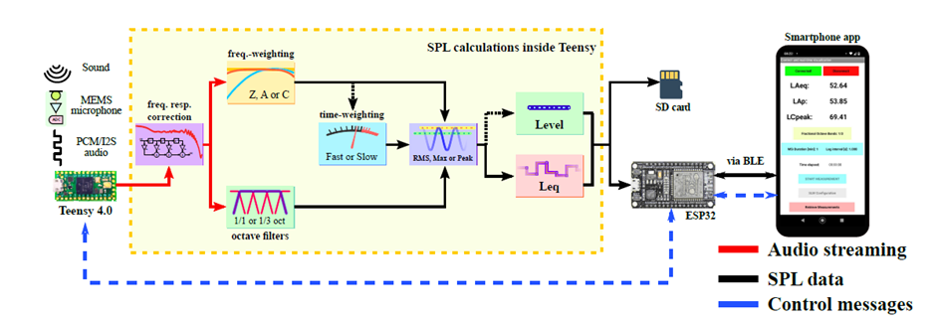
Fig. Signal data flow diagram

Slide 16
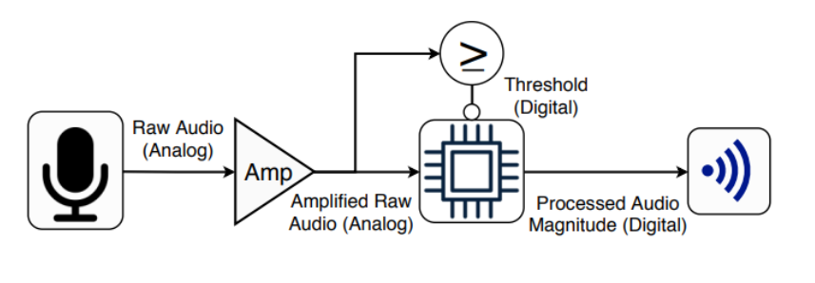
Literature survey
I. Power efficient audio acquisition system
The authors[9] presented the power efficient design of a testbed for a smart microphone system. The microcontroller (Node MCU) and an Analog-to-Digital Converter (ADC) dynamically switch between high and low power modes in response to environmental noise. Specifically, the high powered components are triggered by a spike in the acoustic noise level. Three wireless technologies, WiFi (2.4 GHz), Bluetooth Low Energy (BLE) 4.0 and Zigbee were examined. They were able to lower the power consumption of a node by 97% when the testbed was tested in an idle state.
Fig. System Overview

Slide 17
Literature survey
J. Noise monitoring system using IOT
The authors[10] proposed a modular and scalable solution for enhancing health and well-being through the use of IoT (Internet of Things) and mobile computing technologies. Their objective was to develop a real-time monitoring system for improved acoustic comfort, with compatibility for mobile computing, data visualisation, analysis, and notifications.
The wireless solution is built around the ESP8266 microprocessor module, which supports the IEEE 802.11 b/g/n networking protocol. Data collected by the system is stored in a SQL Server database. To facilitate data access and user interaction, the authors developed a mobile application called 'iSoundMobile.' This approach offers advancements in installation and configuration, thanks to the utilisation of wireless communication technology.

Slide 18
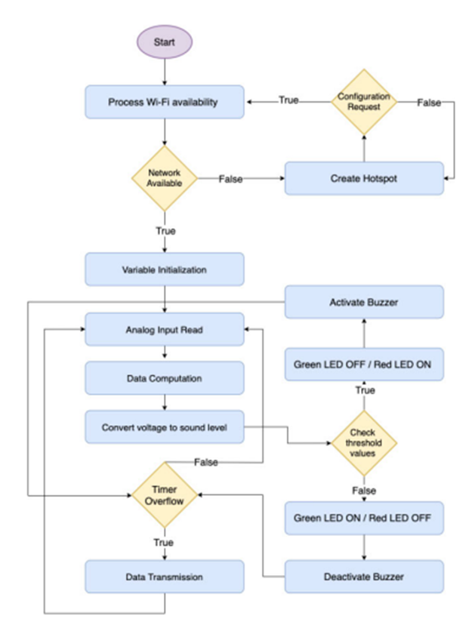
Fig. flowchart

Slide 19
Literature survey
K. Smart Audio Sensing for anomaly detection
The authors[11] proposed a design framework for smart audio sensors able to record and pre-process raw audio streams, before wirelessly transmitting the computed audio features to a modular IoT gateway.
Teensy, is a versatile and powerful development platform for embedded projects compatible with the Arduino Environment, thanks to the Teensyduino libraries.These libraries provide additional features and operations for real-time audio processing. This enables developers to create sound-reactive projects with reduced costs.
A noise detection algorithm was also built as a microservice which is capable of detecting audio anomalies in real-time. They adopted two different anomaly detection algorithms, namely Elliptic Envelope and Isolation Forest, that were purposely trained and deployed on an affordable IoT gateway to detect anomalous sound events happening in an office environment.

Slide 20
Literature survey
L. SNL based detection system
Authors[12] implemented a Sound Noise Level (SNL) detector to measure noise levels, using the Arduino Uno for data processing. The instrument functions as a noise detector, capable of displaying noise level notifications on an LCD indicator and through a beeper. The system utilises a condenser microphone and the LM567 IC op-amp to convert sinusoidal sound waves into AC signals, which are then interpreted by the Arduino Uno. The setup includes indicator LEDs, a sound beeper, and a 16x2 LCD screen. This SNL detector can accurately measure and display noise levels within a range of 50-100 dB and provides audiovisual notifications for detected noise levels.

Slide 21



Process
We utilise the JHD162A, a 16x2 LCD, to present the volume or sound intensity level to the user when sound is detected in the surroundings.
The sound sensors employed in the project encompass the CZN-15E, a mic-based sensor with the LM393 IC acting as a voltage comparator.
The microcontroller chosen to interface with all the sensors, LCD, and LEDs, and to execute the necessary operations, is the Arduino Uno R3.
Additionally, we use the MAX9814, a cost-effective, high-quality microphone amplifier featuring automatic gain control and a low-noise microphone bias. The KY-037 is also incorporated,

Slide 22
Components Purchased
2 Breadboard
Multiple LEDs
16x2 LCD Display
Multiple Jumper Wires
Potentiometer
Arduino UNO
LM-393 based sound senor
KY-037 sound sensor
MAX 9814 sound sensor

Slide 23
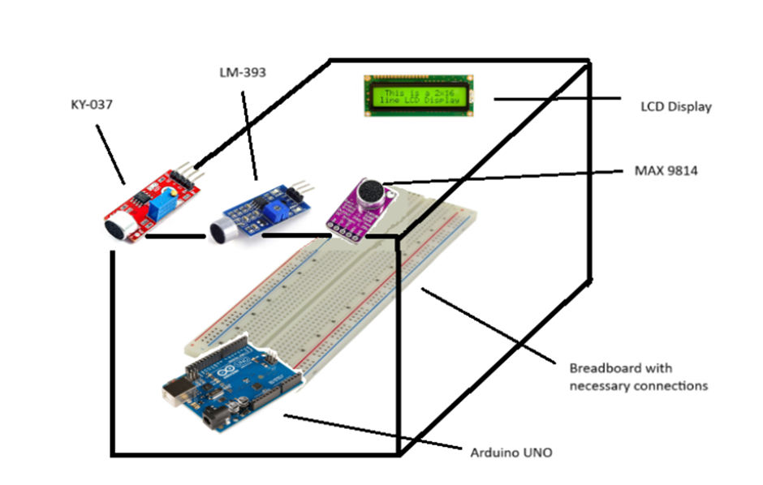
Fig. Experimental Setup

Slide 24
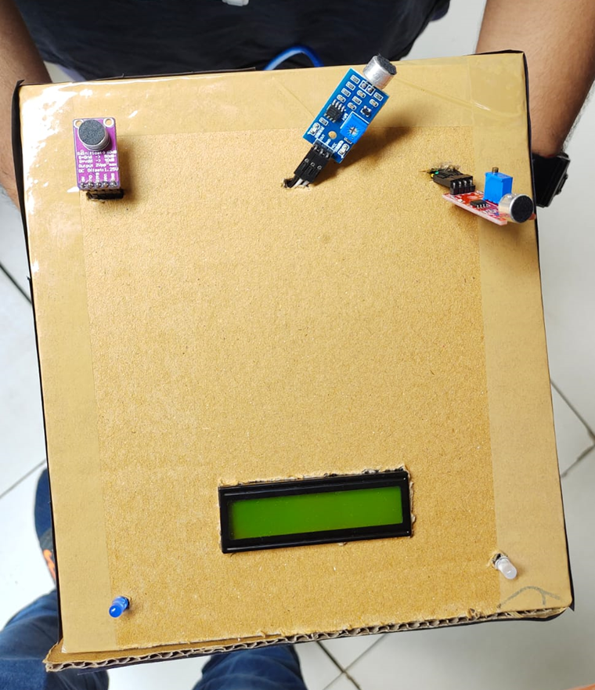
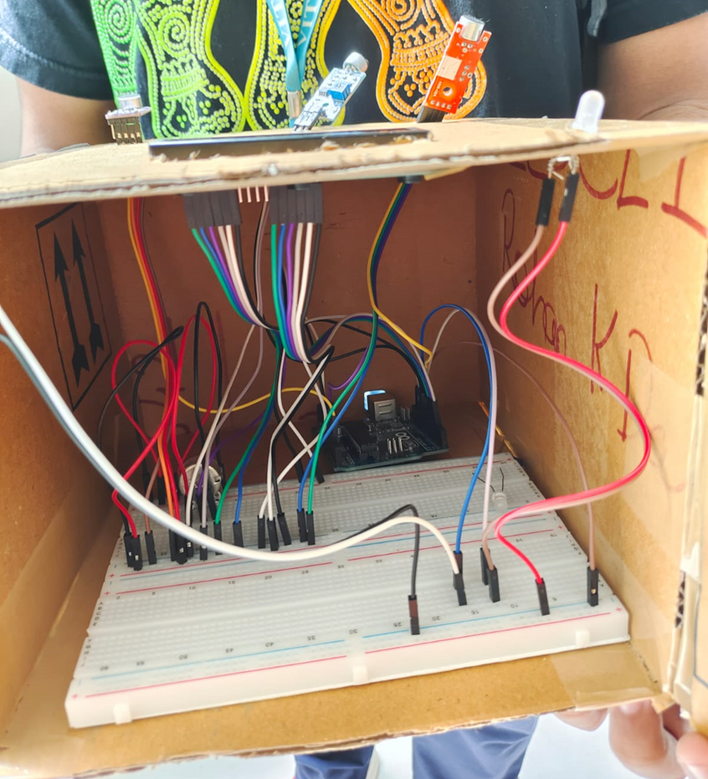
Fig. External structure
Fig. Internal structure

Slide 25
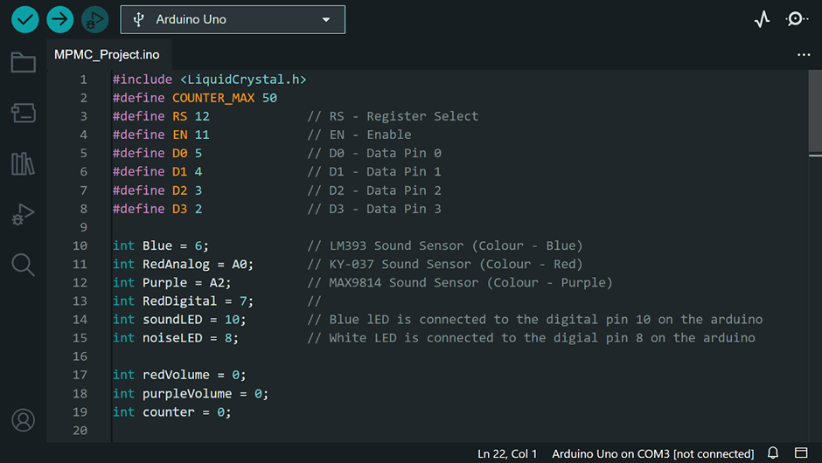
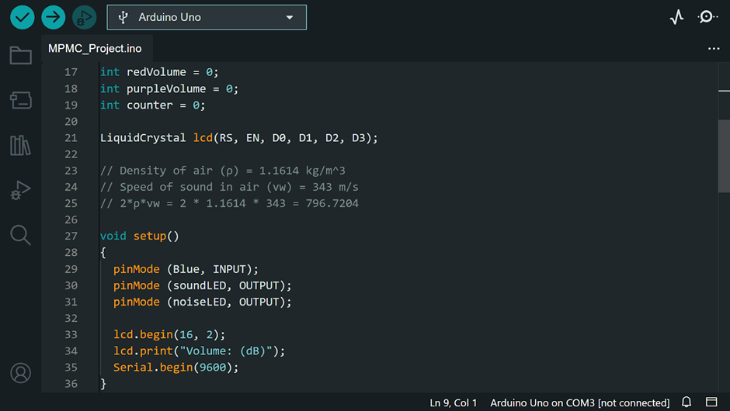


Code

Slide 26


Slide 27


Result
Result 1
Result 2
To provide visual indicators for the environmental state, we integrate two LEDs:
A blue LED signifies the presence of any sound.
A white LED signals a loud noise or disturbance.
We understand and analyse the noise threshold value and silence levels using the graphs

Slide 28
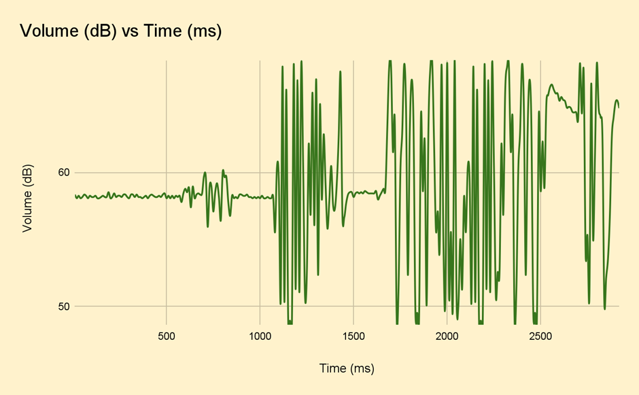

Slide 29


Conclusion
Our primary aim is to offer a detailed evaluation, consolidating crucial research insights to empower informed decision-making. By presenting an affordable and portable implementation, including the capacity to record noise in different directions, it aspires to guide the effective application of these measures, ensuring a tangible reduction in the detrimental effects of noise in one’s surroundings.

Slide 30


Future Scope
1.
A potential avenue for future development involves integrating Wi-Fi or Bluetooth connectivity, enabling remote and wireless monitoring through a dedicated smartphone app or website.
2.
implementation of data logging features to capture noise levels over extended periods. Analysing this recorded data could unveil trends and patterns in noise pollution within a specific locality.

Slide 31
References
[1] Cai, M., Zhong, S., Wang, H., Chen, Y., & Zeng, W. (2017). Study of the traffic noise source intensity emission model and the frequency characteristics for a wet asphalt road. Applied Acoustics, 123, 55-63.
[2] Desarnaulds, V., Monay, G., & Carvalho, A. (2004). Noise reduction by urban traffic management. Proceedings ICA 2004.
[3] Lee, H. M., Luo, W., Xie, J., & Lee, H. P. (2022). Traffic Noise Reduction Strategy in a Large City and an Analysis of Its Effect. Applied Sciences, 12(12), 6027.
[4] Huang, B., Pan, Z., & Wang, G. (2015). A methodology to control urban traffic noise under the constraint of environmental capacity: A case study of a double-decision optimization model. Transportation Research Part D: Transport and Environment, 41, 257-270.
[5] Li, M., van Keulen, W., van de Ven, M., Molenaar, A., & Tang, G. (2014). Investigation on material properties and surface characteristics related to tyre–road noise for thin layer surfacings. Construction and Building Materials, 59, 62-71.
[6] Stoilova, K., & Stoilov, T. (1998). Traffic noise and traffic light control. Transportation Research Part D: Transport and Environment, 3(6), 399-417.

Slide 32
[7] Wong, C. L., Chau, W., & Wong, L. W. (2002). Environmental noise and community in Hong Kong. Noise and Health, 4(16), 65.
[8] Mello, F. R. D., & Fonseca, W. D. A. (2023, February). Autonomous noise monitoring system based on digital MEMS microphones: development of a smartphone application for remote communication. In INTER-NOISE and NOISE-CON Congress and Conference Proceedings (Vol. 265, No. 2, pp. 5650-5661). Institute of Noise Control Engineering.
[9] Fallis, E., Spachos, P., & Gregori, S. (2020). A power-efficient audio acquisition system for smart city applications. Internet of Things, 9, 100155.
[10] Marques, G., & Pitarma, R. (2020). A real-time noise monitoring system based on internet of things for enhanced acoustic comfort and occupational health. IEEE Access, 8, 139741-139755.
[11] Antonini, M., Vecchio, M., Antonelli, F., Ducange, P., & Perera, C. (2018). Smart audio sensors in the internet of things edge for anomaly detection. IEEE Access, 6, 67594-67610.
[12] Rajagukguk, J., & Sari, N. E. (2018, March). Detection system of sound noise level (SNL) based on condenser microphone sensor. In Journal of Physics: Conference Series (Vol. 970, No. 1, p. 012025). IOP Publishing.

Slide 33






